Slide 1
Established since 1988

Slide 2
Management & Leadership
Poly Products Management
Anilkumar
Managing Partner
Arunkumar
Partner
Venugopalan
Partner

Slide 3
We at Poly Products
Our Mission:
“To promote a Quality First culture across our institution and adding values to our esteemed business associates and customers.”
Our Vision:
“To become a premier global manufacturer of injection molded engineering plastic components.”

Slide 4
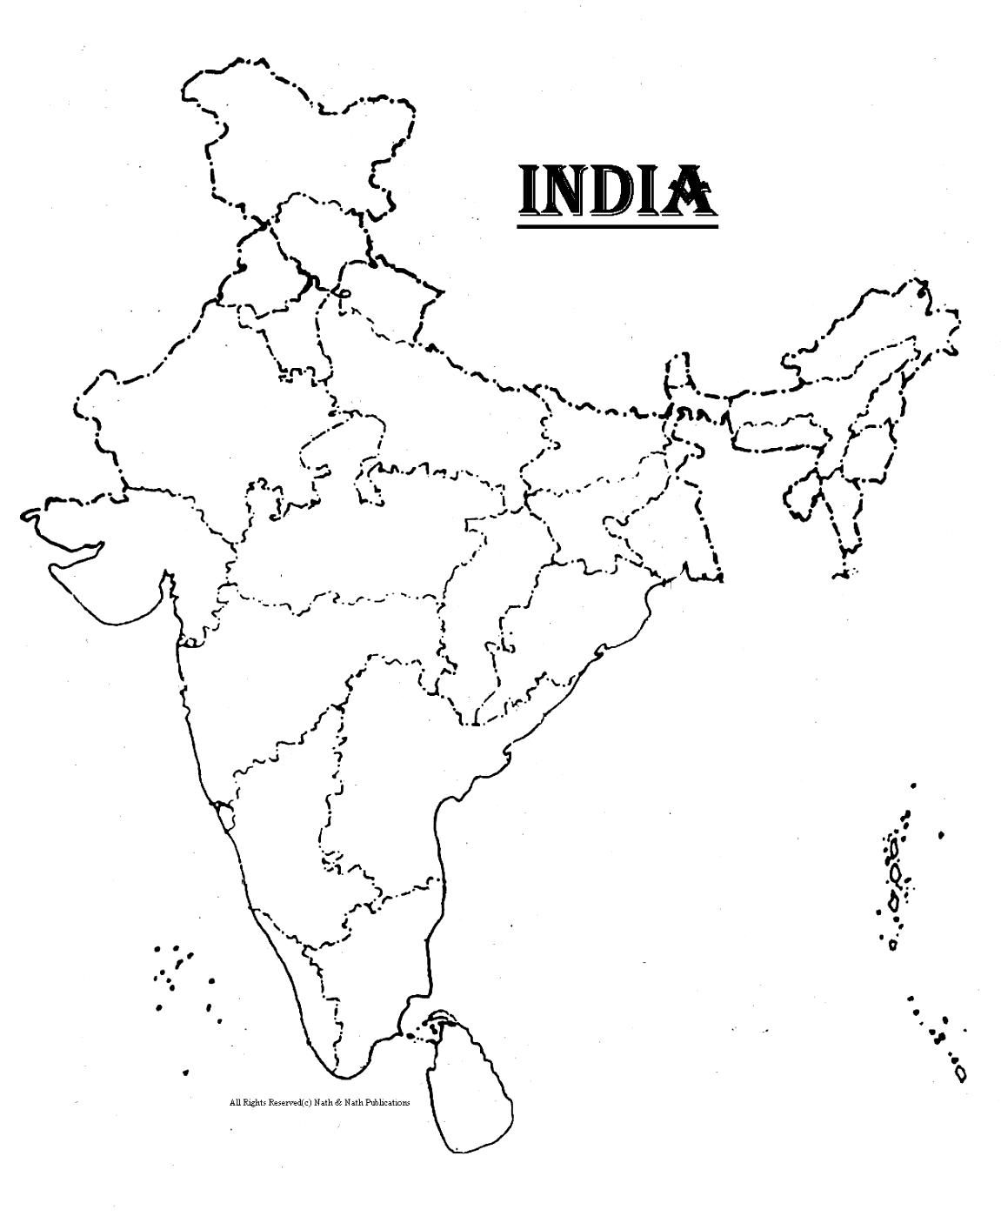
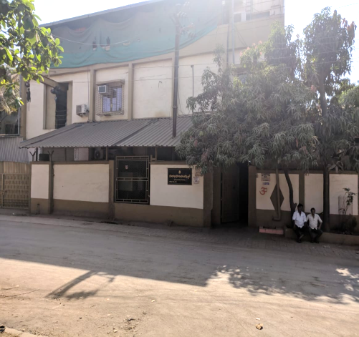
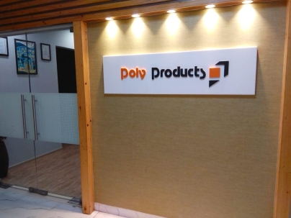
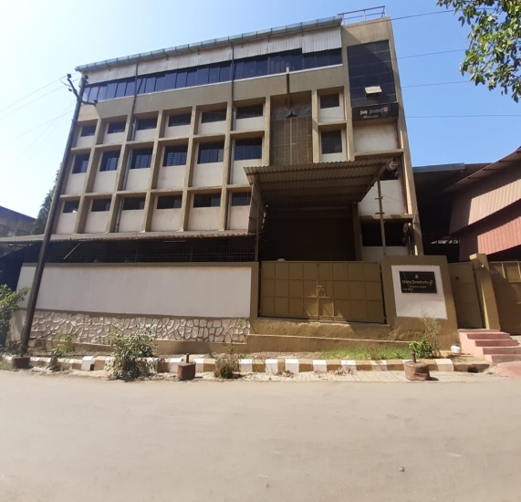
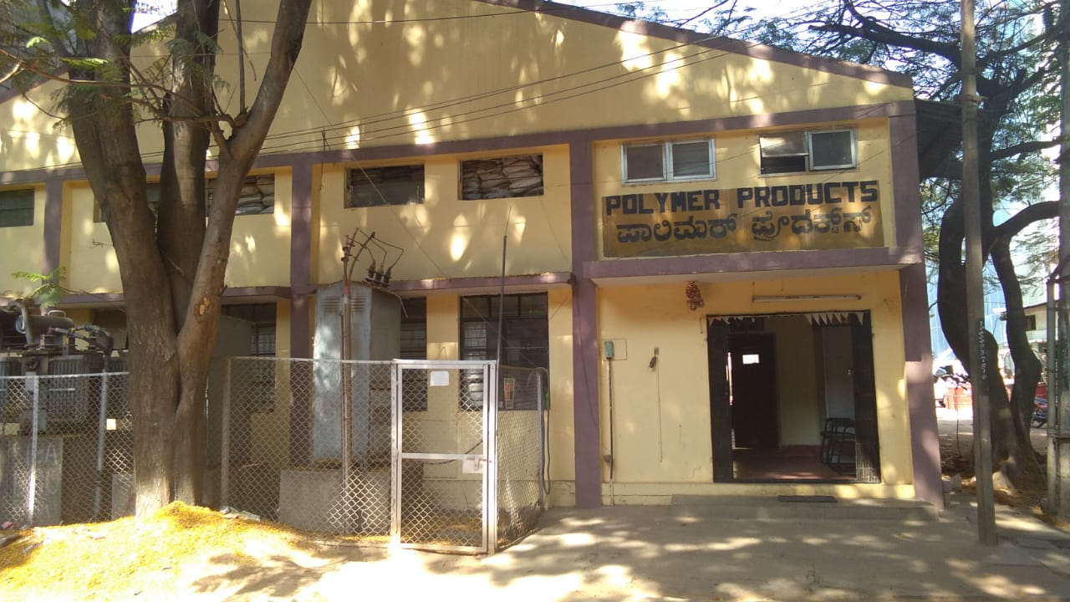
Where can you find us ?
Mumbai with a 60,000 sq. ft. facility and a corporate office situated at Gauraipada, Vasai (East),Maharashtra.
info@polyproducts.com sales@polyproducts.com
+918425892908 , +919920031702, +919820037316, 0250-2452233/34
www.polyproducts.com
A 50,0000 sq. ft. facility at Whitefield, Bengaluru, Karnataka.
sreemathaind@rediffmail.com
+91 9886116325

Slide 5
Our Manufacturing Capabilities
Ultrasonic Welding
Injection Molding
Blow Molding
Tool Room and Designing
CNC Lathe Machining
SS Insert Press Fitting

Slide 6
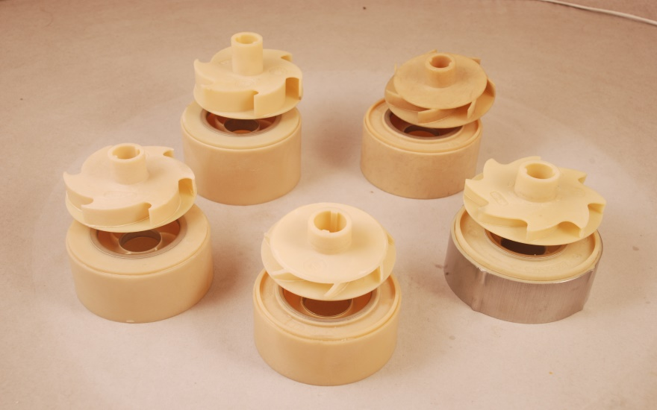
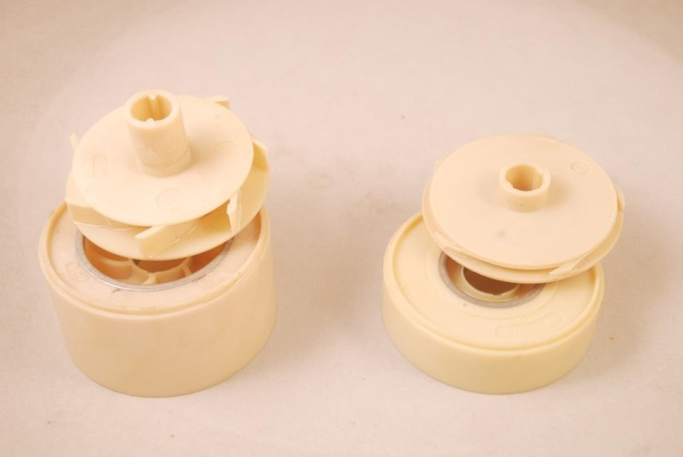
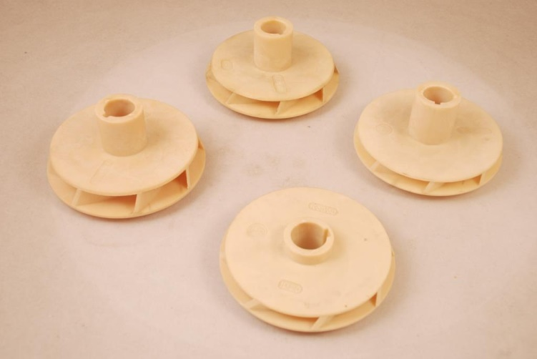
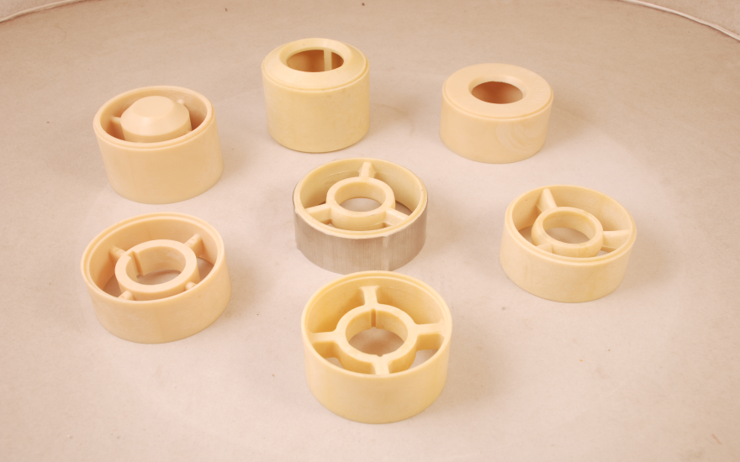
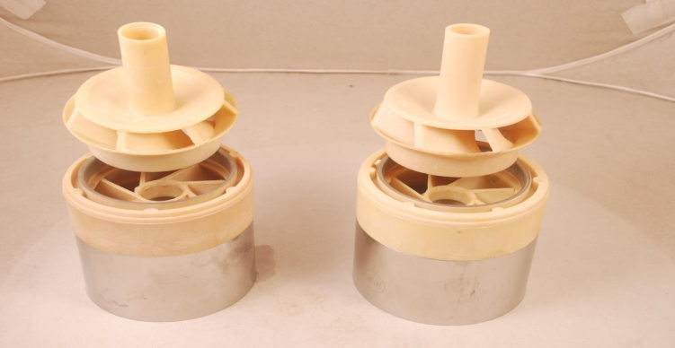
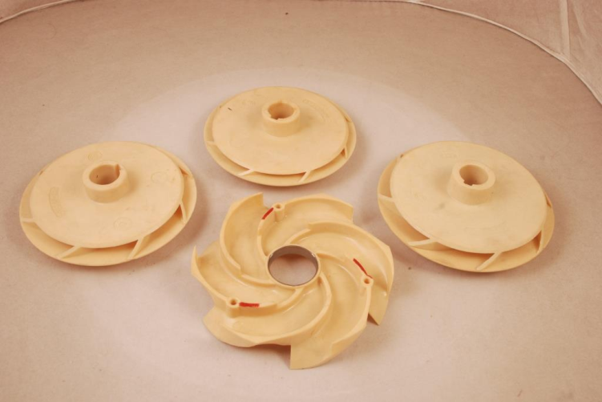
Submersible Pump Components
3”
4”
6”

Slide 7
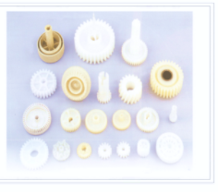
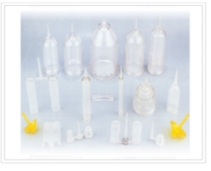
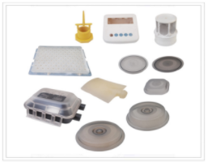
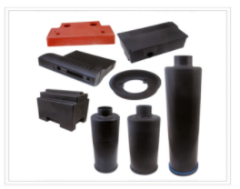
Submersible Pump Components
Open Well & Mono Impellers
Industrial Components

Slide 8
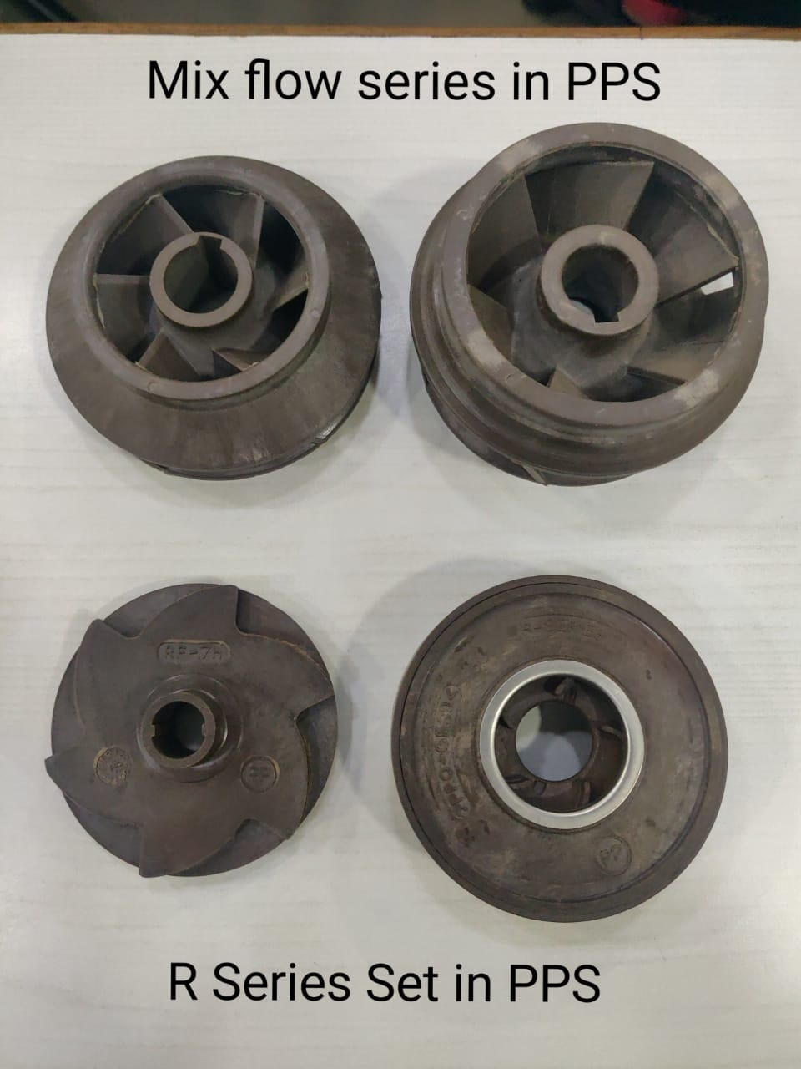
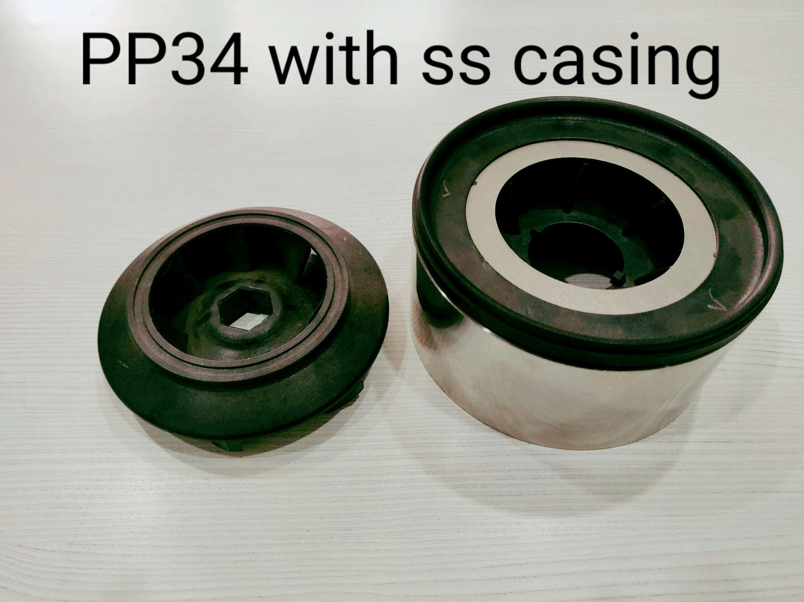
New R&D Initiatives
Material : PPS (Polyphenylene sulphide-glass filled 40% )
Benefits :
Value for Money
High Sand Abrasion Resistance
High HDT (Heat distortion or Heat deflection Temperature) @ above 250 °C
Will not have an adverse impact on the product during unforeseen dry runs

Slide 9
Our Major Customers

Slide 10
THANK YOU

