Slide 1


Lockdown Trainings
Remote training platform and allied services

Slide 2

The need of the hour
A Remote Training Platforms (RTP) was always felt necessary (for the vastly spread-out field forces).
This has become an urgency now…particularly, under this Covid-19 Lockdown period.
The target groups to reach and engage through this platform are:
  Sales Personnel
  Logistics Forces
  Customer Support Personnel
  Backend Teams (Including Accounts / Admin)
  Installation and Repairing Task-forces
  Trade Influencers (Painters, Fabricators, Electricians, Plumbers, etc.)
  …and many more.

Slide 3

Remote Training Platform
Quick to Implement
Mobile Ready
Scalable

Slide 4

Key Features
Micro modules … easy to learn, easy to remember.
More visual communications rather than text.
Indian languages for texts.
Simple voice over (Hindi, Eng. and some other Indian languages on request).
On-the-go tips and questions… (in-between videos or slides).
Time-bound participation assessments.
Mobile Certification.
Carry on resources for downloading.

Slide 5




Engaging contents
Audio visual content with engaging interactions
Create once, works across all devices
Ready to use layouts and templates
Supports all languages, one click translate

Slide 6
Analytics and Reporting
Management reports
Reminders & escalations
Organizational leaderboards

Slide 7



Micro-certifications that work
Create engaging content
Deploy to field with a click
Track and push learning

Slide 8

Suitable Training Modules
Product Launches.
Scheme Announcements.
Developing Selling Skills.
…Soft Skills.
Process Trainings.
Accounting Norms.
Usage guides.
Installation / Repairing Techniques.
Visual Merchandising Protocols
Store Management SOPs.
Customer Issue Handling, etc.

Slide 9
Campaign flow
Course Registration on Platform
Content Creation using existing Templates and Tools
Exams & Certificate Creation
Add Participants by Region, Group, etc.
Preview and Publish Course
Send Invites by SMS Link to join the course
Track and monitor Course utilization
Admin:
Participant:
Action 1
Logs into Platform using link, through mobile browser or download App
Action 2
Logs in with unique code and OTP
Action 3
Learn the interactive course and join Quiz at the end.
Action 4
Score Pass Mark & Download Mobile Certificate
# Value added off-line follow-up, reward pay-outs and Tech support.

Slide 10
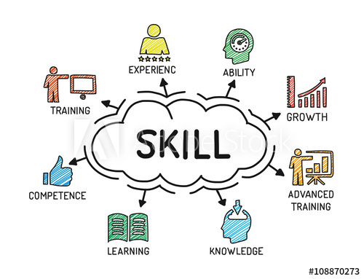
Why do this?
Quick and dynamic content distribution
Highly scalable
Training on the go…anywhere
Reminders
Certifications and Rewards
Track performance vis-à-vis training levels
Protection from fast churning FOS

Slide 11



Trusted by companies with 1000s of distributed staff spread over 100s of cities.

Slide 12

TimeLine (Post approval)
Platform Setup and Registration – Day1.
Content Development – Day 4 (if the materials are all ready).
Flow Testing & Invitation sending out (SMS)– Day 5
Tele-follow-up / SMS Follow-up - Day 6
Training Roll-out – Day 7

Slide 13
Commercials
Platform Registration - FREE (For our Existing Clients)
Course and Mobile Set-up : Rs.55000/- per Course
(Creative charges, recording, etc. would be
additional).
Invitation and Tele-Calling: Rs. 50/- per participants.
Course Fee: Rs. 850/- *per person per module.
Payment Term: 50% along with P.O. Rest within 15 days of uploading the course.
Minimum 500 Participants.
IGST 18% as applicable

Slide 14

Thank You
Avijit@offbitmktg.com
9916989683
Skype: aviconnect

